Slide 1
بِسْمِ اللهِ الرَّحْمٰنِ الرَّحِيْمِ
In the name of Allah, the Most Gracious, the Most Merciful

Slide 2




Zenix Travel Companion
Your Smart AI Guide for Stress-Free Travel

Slide 3
Our Team
02
03
04
01
Tayyab Kalid
Talha Rana
Hamza Bin Zafar
Zara Bizenjo

Slide 4

Project Overview
AI-powered travel assistant
Smart planning and itinerary
management
Real-time translation and cultural tips
Intuitive neon-themed interface

Slide 5

Problem Statement
Travelers face language barriers and
cultural misunderstandings
Trip planning and budget management
are often inefficient
Existing apps offer fragmented,
non-integrated tools
This results in frustration and suboptimal
travel experiences

Slide 6




Proposed Solution
A unified AI-powered platform combining all key travel tools
Real-time translation, personalized itineraries, and cultural insights
Includes budget planning and interactive navigation
Delivers a seamless and intuitive all-in-one user experience

Slide 7

Features
AI Travel Chatbot – Real-time conversational travel assistance
Audio Translator – Speech-to-text and multilingual translation
Cultural Explorer – Historical and cultural insights
Smart Itinerary Planner – Day-by-day travel planning
Budget Estimator – Cost analysis and financial planning

Slide 8

Features
Currency Converter – Real-time exchange calculations
Route Planner – Navigation and mapping integration
Travel Trivia – Interactive educational quizzes
Feedback System – Community reviews and ratings

Slide 9

Features

Slide 10
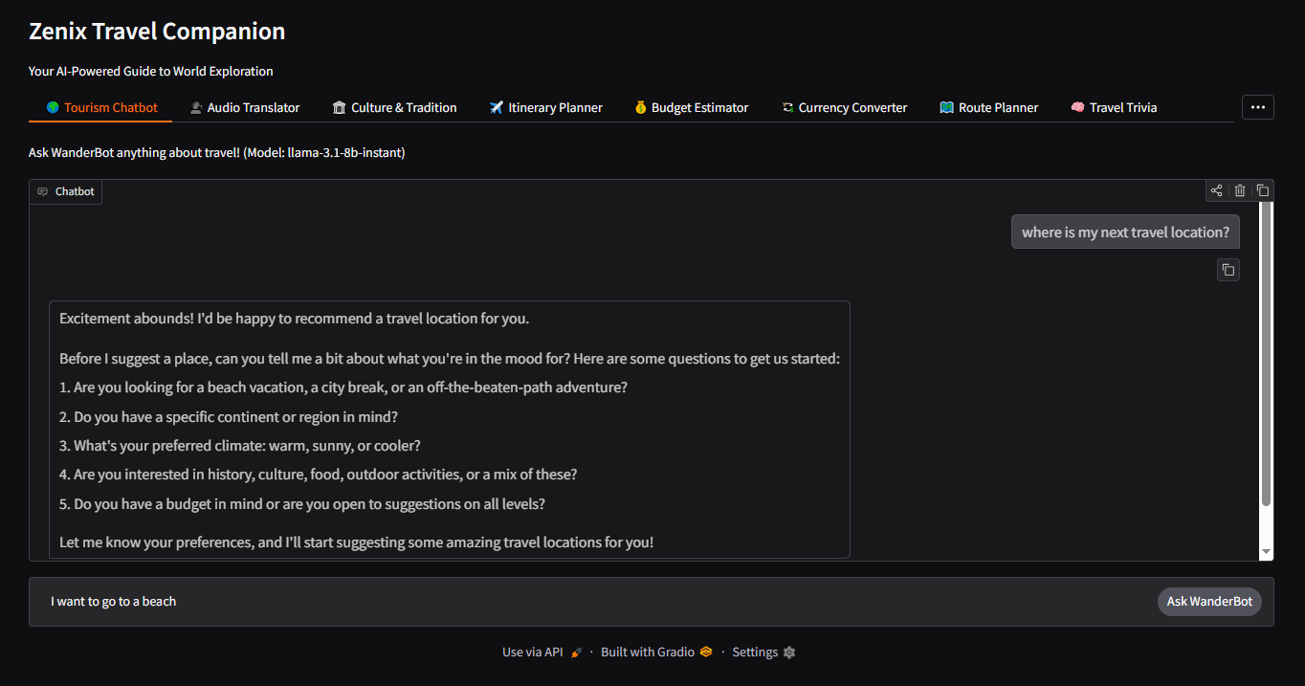
1
Features
AI Travel Chatbot – Real-time conversational travel assistance

Slide 11
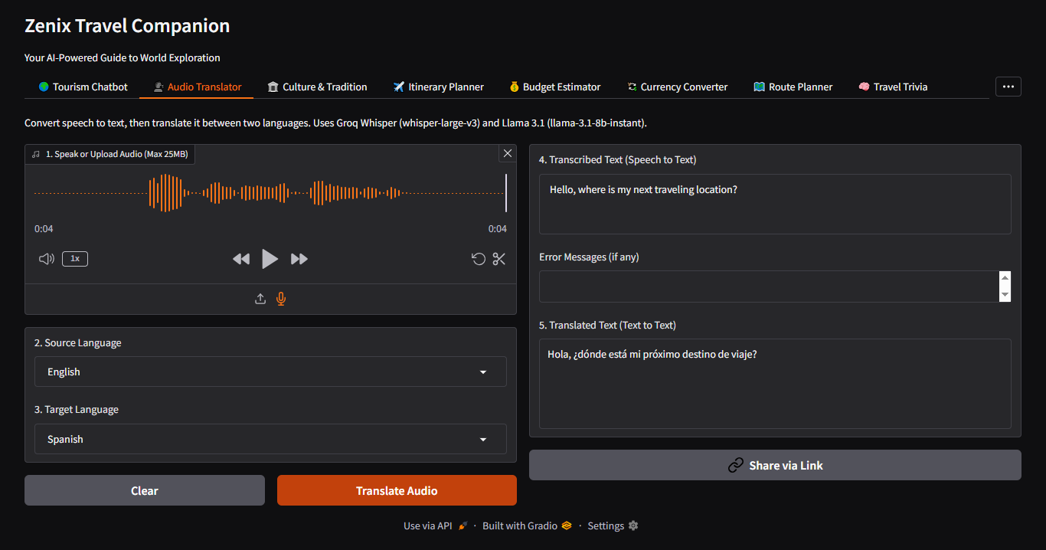
2
Features
Audio Translator – Speech-to-text and multilingual translation

Slide 12
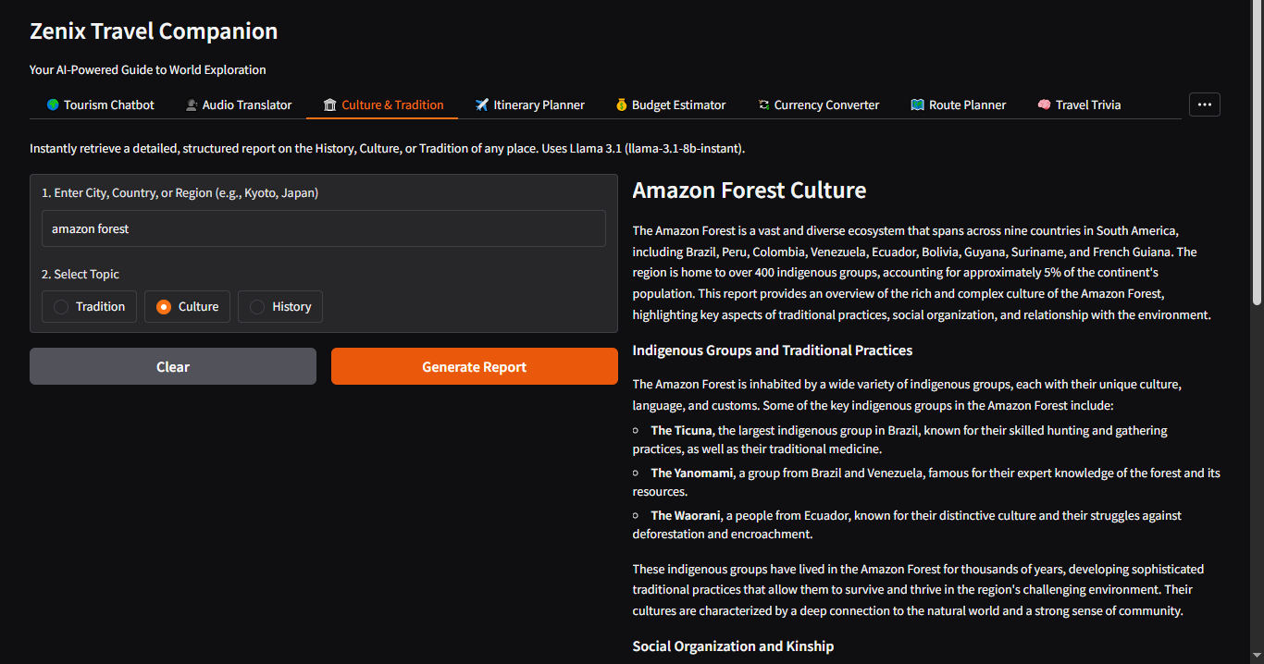
3
Features
Cultural Explorer – Historical and cultural insights

Slide 13
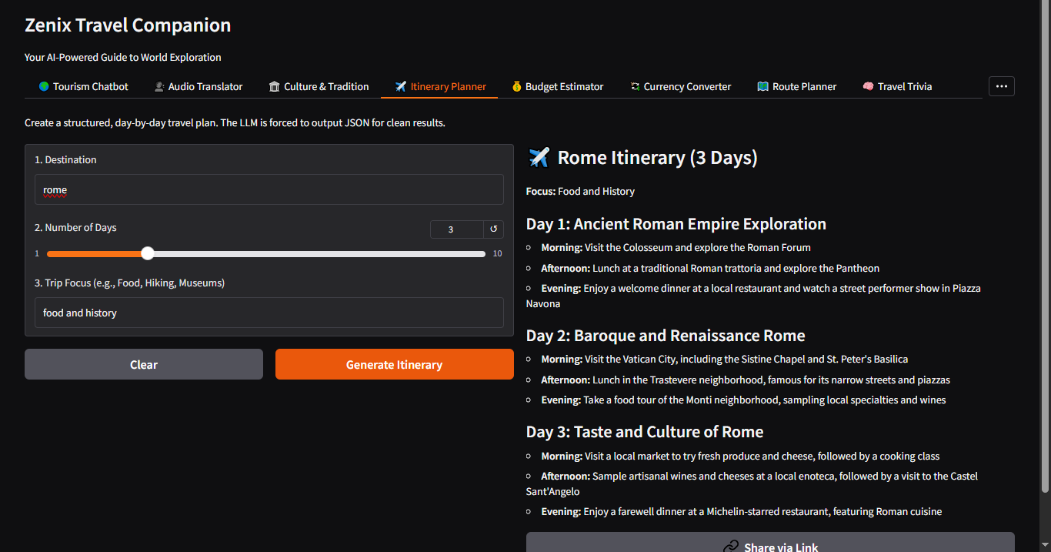
4
Features
Smart Itinerary Planner – Day-by-day travel planning

Slide 14
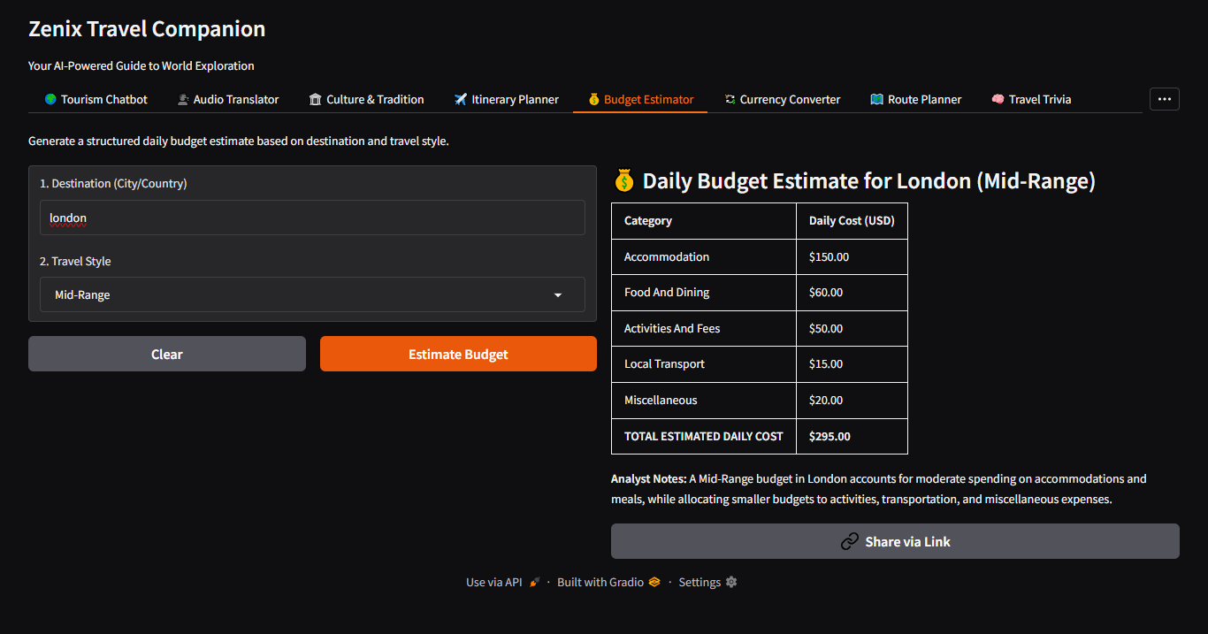
5
Features
Budget Estimator – Cost analysis and financial planning

Slide 15
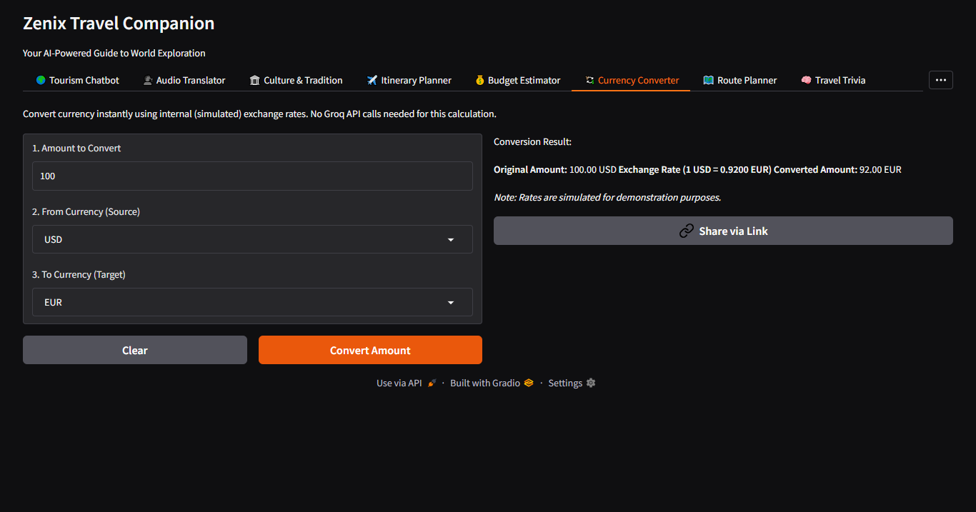
6
Features
Currency Converter – Real-time exchange calculations

Slide 16
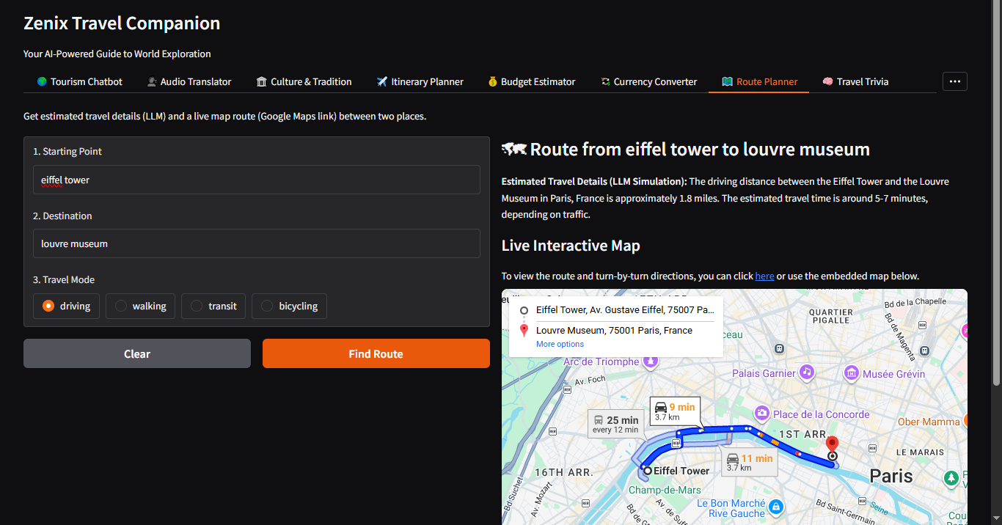
7
Features
Route Planner – Navigation and mapping integration

Slide 17
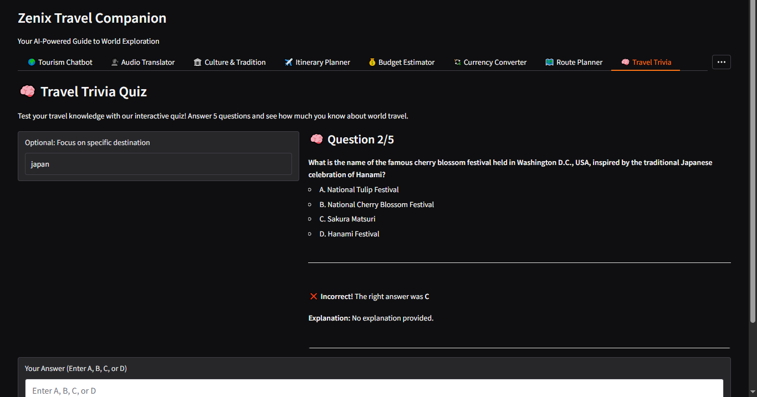
8
Features
Travel Trivia – Interactive educational quizzes

Slide 18
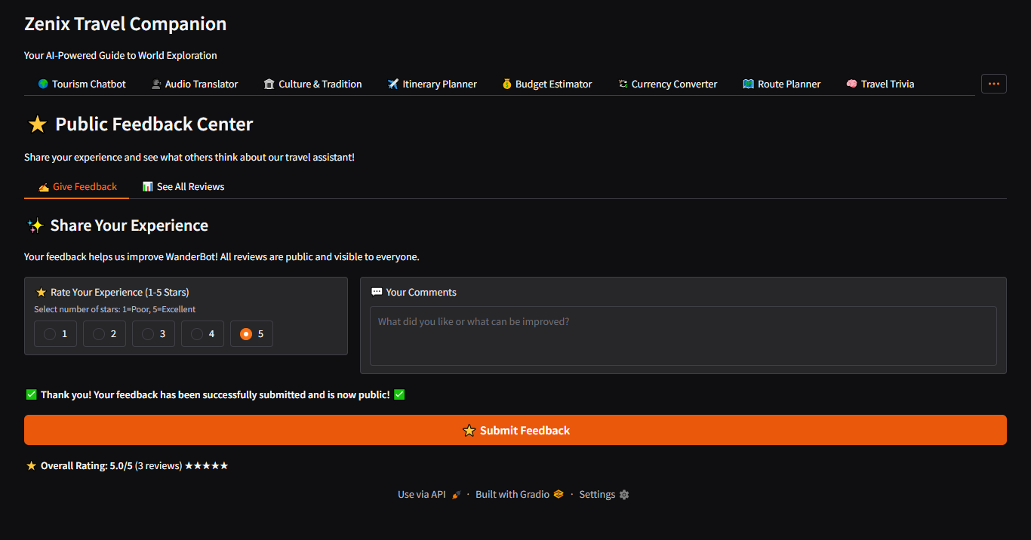
9
Features
Feedback System – Community reviews and ratings

Slide 19

Technologies
Groq AI API & Python – High-speed LLM backend
Gradio & SQLite DB – Web interface & storage
Google Maps – Route planning integration
Whisper Model – Speech recognition

Slide 20
Business Plan
This is just a prototype demonstrating core functionality.

Slide 21
Startup Development Strategy
Mobile Apps – iOS & Android
Freemium Model – Premium AI features
Target Market – Global Travelers
Revenue Streams – Subscriptions & Licensing

Slide 22
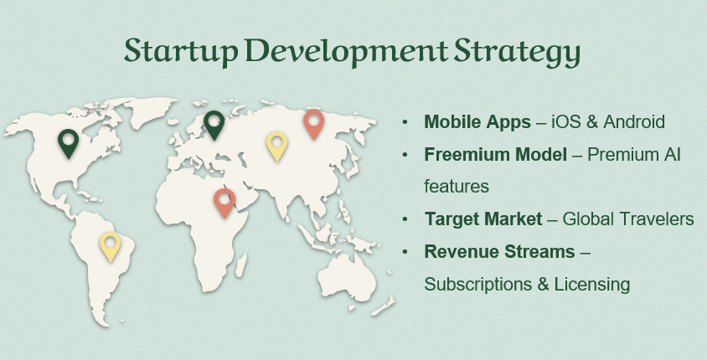
Global Impact Vision
Target Audience – Global Travelers
Localization – Multi-Language Support
Cultural Bridge – Cross-Cultural Experience
Accessibility – Easy Travel Planning

Slide 23


Thanks!

Slide 24
02
03
04
Zenix Travel Companion
01
Tayyab Kalid
Talha Rana
Hamza Bin Zafar
Zara Bizenjo

